Slide 1
Selling Details of Cars
Presentation by:
Kalyan Kumar Bhogi
College of Professional Studies
Northeastern University, Boston Campus
Prof. Kayal Chandrasekharan
2023, Feb 14^{h}

Slide 2



Agenda
1. Introduction
2. Summary of Data
3. Visualizations of Data set
4. Bibliography
5. Conclusion
6. Question &Answer

Slide 3
Introduction:
The data set consists of 2971 records and 13 attributes .This dataset is all about Selling Details of cars for 33 years (1983-2020) which can give us an idea about all the selling details including Year, Price, KM’s Driven, Seller type, Transmission, Mileage Owner, Engine, Maxpower, Torque and No. of seats that are available to each car.
Based on these details, we can answer a few questions:
• What is the individual percentages of ownership of cars, which all are selling from 1983 to 2020?
Which is the most used fuel for all cars which all are selling from 1983 to 2020?
Which type of seller has the maximum contribution of selling the cars from 1983 to 2020?
Which seller category had the highest contribution to car sales from 1983 to 2020?
Which was the most popular transmission sold from 1983 to 2020?
How had the selling price changed over time between 1990 and 2020?

Slide 4
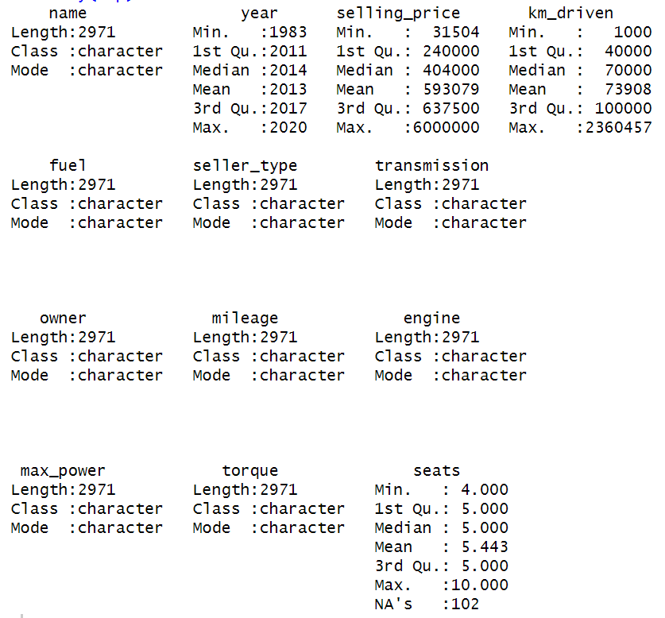
Summary of Data:
A generic function called summary is used to provide results summaries for various model fitting algorithms. Specific methods that are dependent on the class of the first argument are called by the function.
A summary function gives the different measures of the data like position, dependency, central tendency.
The summary of the dataset gives an idea about the total attributes i.e., 13. It shows the mean of all selling details of cars. If we compare the details of all 13 sources of car details, we get an idea that the how many types of Transmission, Types of fuels,Sekking price details and we can get each details over period of 1983-2020

Slide 5
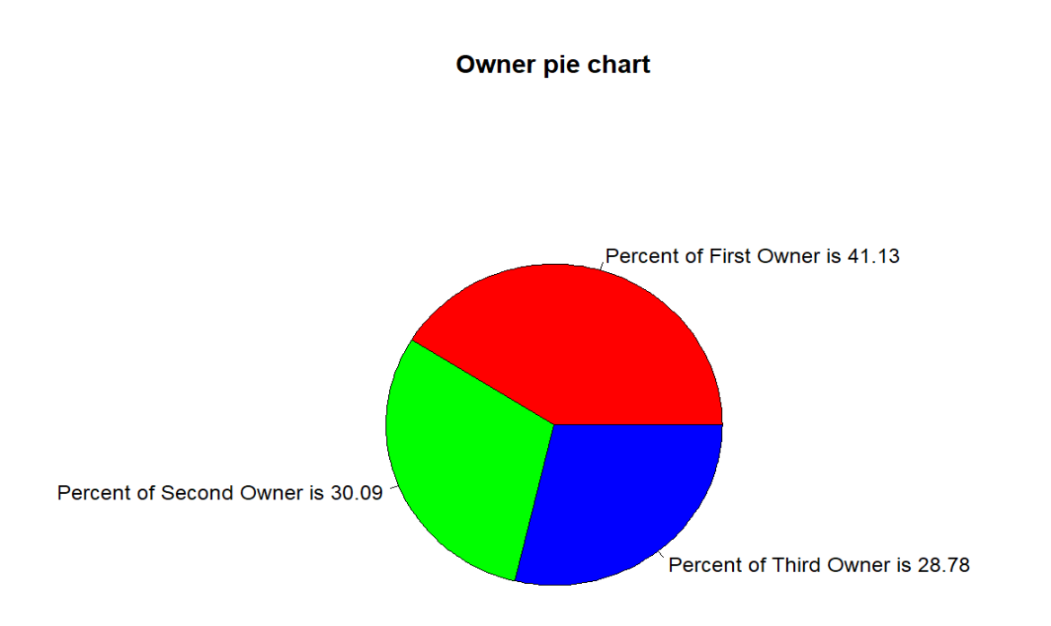
Types of Owners to all cars from 1983 to 2020
What is the individual percentages of ownership of cars, which all are selling from 1983 to 2020?
To find the individual percentages of ownership of cars, we plotted a Pie chart between all the owners.
As we can see here that, First owner has the highest percentage of ownership with 41.13 while the third owner has the lowest percentage of ownership with 28.79.

Slide 6
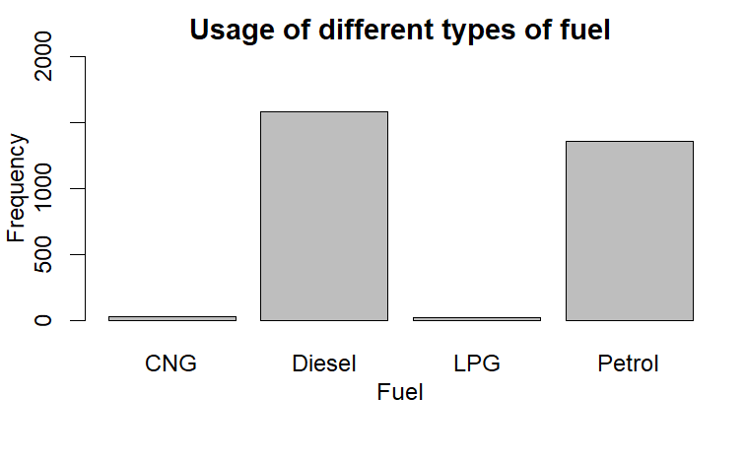
Fuels used to all cars from 1983 to 2020
Which is the most used fuel for all cars which all are selling from 1983 to 2020?
To find the usage of different types of fuel for all the cars, we plotted a Bar chart between all fuels.
As we can see here that, Among the 4 fuels Diesel is most used fuel, petrol is the 2nd most used fuel and CNG,LPG ranks 3rd & 4th positions.

Slide 7
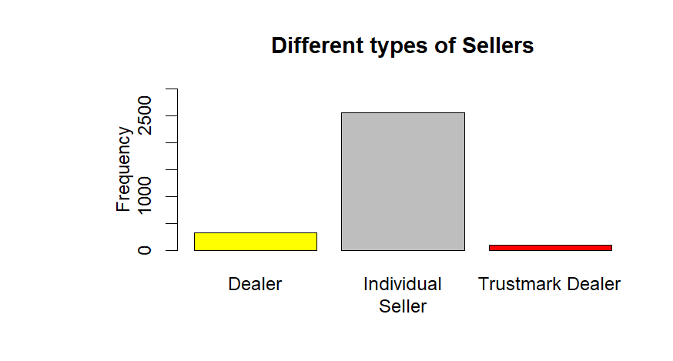
Seller types for all cars from 1983 to 2020
Which type of seller has the maximum contribution of selling the cars from 1983 to 2020?
To find the different types of sellers for all the cars, we plotted a Bar chart between all types of sellers.
It seems that the majority of car sellers are individual sellers, followed by dealers, while Trustmark Dealers have the smallest share of car sales.

Slide 8
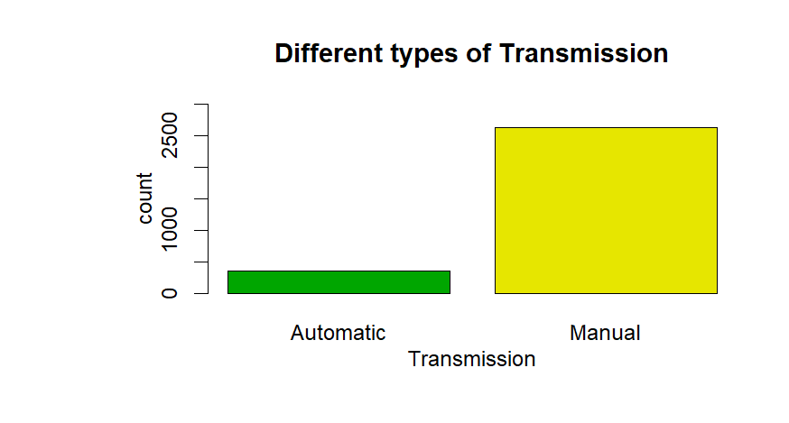
Transmission of all cars from 1983 to 2020
Which type of Transmission has the maximum contribution of selling the cars from 1983 to 2020?
To find the different types of Transmission for all the cars, we plotted a Bar chart between all types of Transmission.
As we can see here that, the majority of the selling cars are of manual transmission type, followed by Automatic transmission.

Slide 9
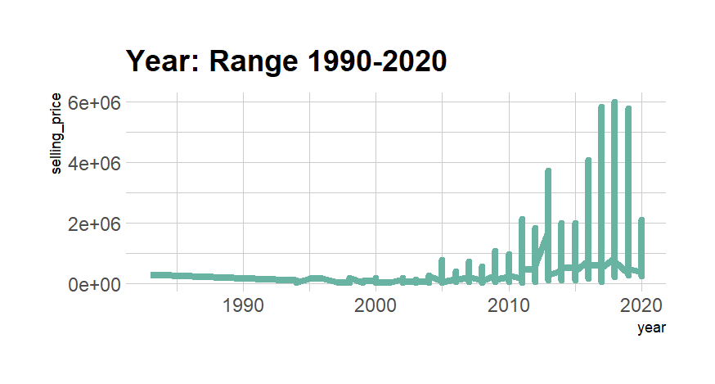
Selling price all of cars from 1990 to 2020
How is the selling price changed over time between 1990 and 2020?
geom_line() connects in order of the variable on the x axis. The stairstep plot produced by geom_step() shows precisely when changes take place. Which situations are connected together is determined by the group aesthetic.
Change in Selling price of various cars from 1983 to 2020. The selling price has been at its peak in the year 2018.

Slide 10
Conclusion

Slide 11
Bibliography
geeksforgeeks. Data Visualization with R and ggplot2, 7 Dec. 2021,Retrieved February 14,2023, from https://www.geeksforgeeks.org/data-visualization-with-r-and-ggplot2/?ref=gcse
Statistics Globe. R Functions List (+ Examples) | All Basic Commands of the R Programming Language, 14 Jan. 2021, Retrieved February 14,2023, from https://statisticsglobe.com/r-functions-list/
GeeksforGeek. R – Pareto Chart, 22 Aug. 2019, Retrieved February 14,2023, from https://www.geeksforgeeks.org/r-pareto-chart
Linear regression in R ,A step by step Guide, 19 June. 2021, Retrieved February 14,2023, from https://www.scribbr.com/statistics/linear-regression-in-r/
GeeksforGeek. Add regression line to ggplot2 plot in R, 6 Jan. 2019, Retrieved February 14,2023, from https://www.geeksforgeeks.org/addregression-line-to-ggplot2-plot-in-r/

Slide 12
Any Questions?

Slide 13
Thank You

